Slide 1
The geographic and social causes of the linguistic patterns in the Zeeje manuscript
SAIL April 2019, Tucson

Slide 2
Introduction
One of the main issues in language description and revitalization is the value of premodern resources and the effect of standardization as a result of codifying the grammatical system of a language.
  How do we interpret/value the analysis of older resources in this context?
  Do differences represent a linguistic change or an analytical one?
  Do differences represent valid yet unique perspectives on the same grammatical phenomenon, thereby making both necessary for the documentation of a language?
  Should differences inform community revitalization efforts, and if so how?

Slide 3
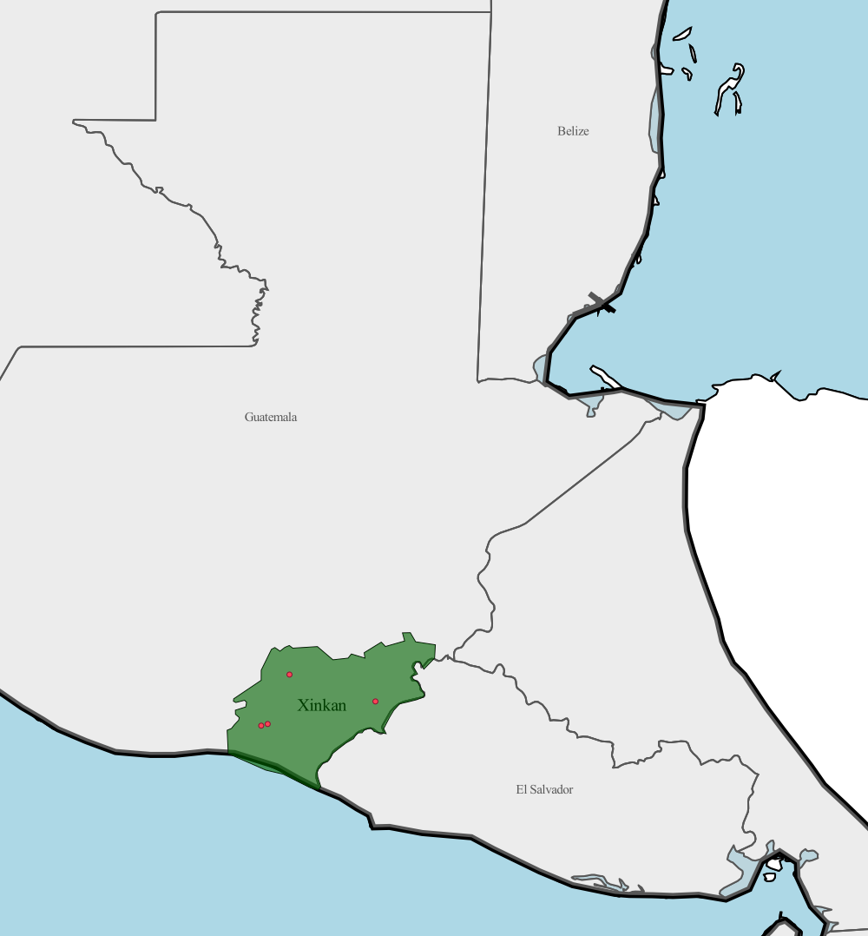
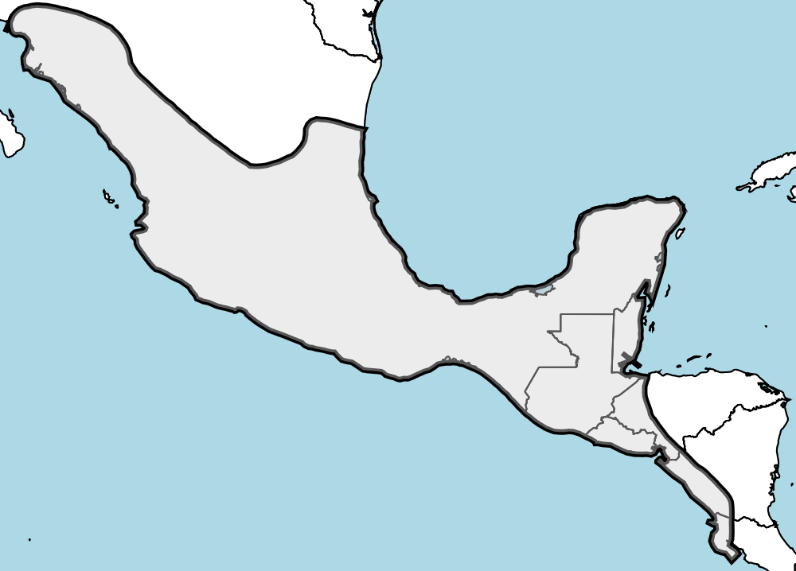
Xinkan languages

Slide 4
Xinkan languages’ resources

Slide 5
The Zeeje manuscript
Proclama a los Habitantes de Ultramar
  August 30, 1812 proclamation by the Spanish Cortes during the Napoleonic wars.
  Bolster support for the new Spanish Constitution
  Encourage loyalty to the Empire
Translations
  The Cortes requested that this proclamation be translated into all languages in the empire (including the native languages) and read aloud in the churches (similar to the new Spanish constitution)
  Only five translations are known: Ixil, Tz’utujil, Kekchi, Quechua, and Zeeje (=Xinkan)

Slide 6
Zeeje manuscript
Translation attributed to Hermenegildo Morales, a secular parish priest in Chiquimulilla, Guatemala, sometime in 1813.
Re-discovered in 1976 by Lawrence Feldman and identified as “Xinkan” by Terrence Kaufman
  No published analysis
  One of the largest Xinkan texts ever recorded (16 folios of handwritten text)
  Zeeje = ts’ehe ‘the town of Chiquimulillla’ (Sachse 2010)
Zeeje Manuscript
Notes:
No extant published analyses
Kaufman (nd) = handwritten transcription with some comments
Sachse (2010) = extracted data examples
Rogers (2010) = focus on last speakers (mentioned but did nothing with the manuscript)
What does it contain? What information about Xinkan is present?

Slide 7
Questions about the manuscript
Comparative question about the nature of the translation
  The others more than double the length of the original.
    What is the nature of the Zeeje translation?
Xinkan-related questions
  Which Xinkan language is represented in the translation?
    There are four known (and three additionally mentioned varieties).
  What grammatical structures are represented in the translation?
    Hermenegildo Morales was not a native speaker.
  Why was this translation made?
    Xinkas have always been marginalized, and early in colonial times were largely ignored.
What other sociolinguistic information adds to the context of this translation?
  Secularization of Eastern Guatemala

Slide 8
Analyses (philology, morphology, and syntax)
Fieldworks Language Explorer
  Interlinear Morpheme Glossed Text and short Vocabulary
    1048 types
    2751 tokens
    838 morphemes
      566 (68%) from Spanish
      272 (32%) from Xinkan
Compared to the Comparative Xinkan Database
  6450 morphemes (for the four documented Xinkan languages)
  3000 example sentences
  35 texts (in GX, CX and JX)

Slide 9
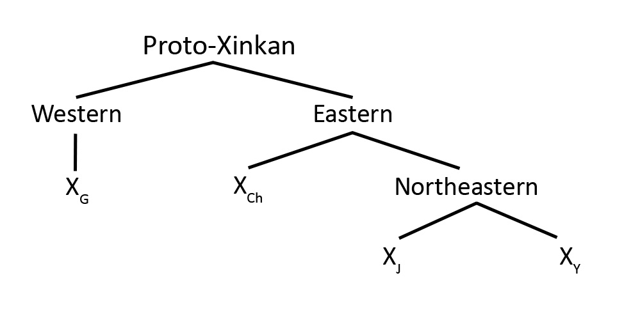
Which Xinkan language is represented in the translation?
ZX: 7/272 = 2.5%
pan-Xinkan: 243/272 = 89%
CX: 11/272 = 5%
GX: 5/272 = 1.8%
JX: 4/272 = 1.5%
YX: 2/272 = <1%

Slide 10
What is the nature of the translation?
Mostly a direct translation from the Spanish original
Orthographic practices follow 18th century Spanish
A few adaptations in Xinkan word choice creating novel meanings
Some Xinkan-like syntax
Evidence of the vigesimal number system
A document mixing all of the languages spoken in the area

Slide 11
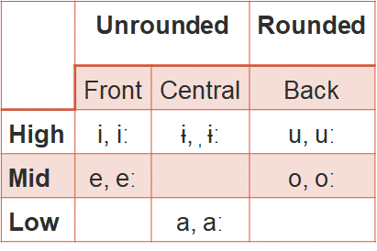
Phonology: vowels
<u> = [u] and [ɨ]
No long vowels
Evidence of static sequential
vowel harmony restrictions

Slide 12
Phonology: vowels
(1) Evidence of Vowel harmony
(2) Evidence of Vowel harmony

Slide 13
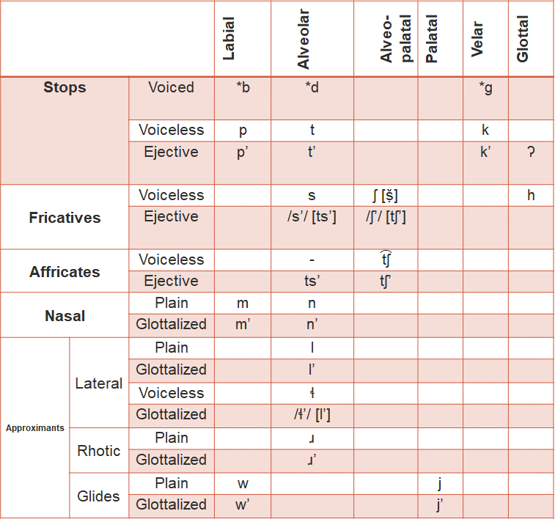
Phonology: consonants
  <lg> = [ɬ] in five words (tokens)
  <s>, <z>, <r> = [ṣ̌]
  <g> = [h], [k]
  <z> =[ts’]
  No C’ or [ʔ]

Slide 14
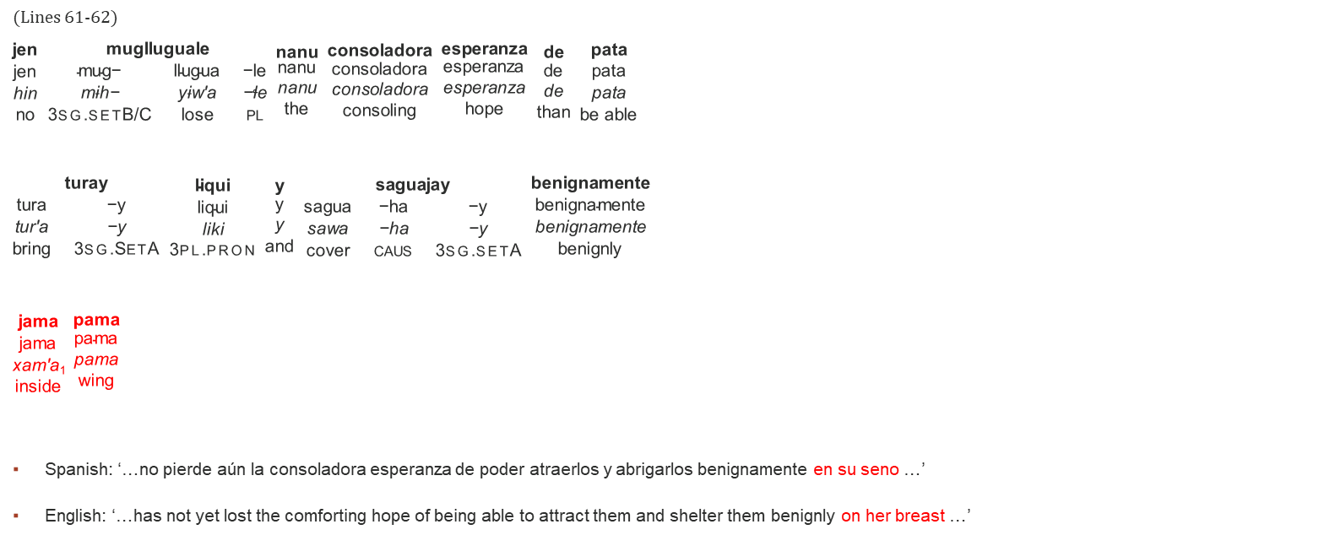
Morphosyntax: word choice
(Lines 61-62)
$\begin{matrix}\text{jen} \\ \begin{matrix}\text{jen} \\ \text{hin} \\ \text{no} \end{matrix}\end{matrix}$ $\begin{matrix}\text{muglluguale} \\ \begin{matrix}\text{mug}\text{− } & \text{llugua} & \text{−}\text{le} \\ \text{m}\text{ɨ}\text{h}\text{− } & \text{y}\text{ɨ}\text{w}\text{′}\text{a} & \text{−ɬ}\text{e} \\ \text{3}\text{sg}\text{.}\text{setB}\text{/}\text{C} & \text{lose} & \text{pl} \end{matrix}\end{matrix}$ $\begin{matrix}\text{nanu} \\ \begin{matrix}\text{nanu} \\ \text{nanu} \\ \text{the} \end{matrix}\end{matrix}$ $\begin{matrix}\text{consoladora} \\ \begin{matrix}\text{consoladora} \\ \text{consoladora} \\ \text{consoling} \end{matrix}\end{matrix}$ $\begin{matrix}\text{esperanza} \\ \begin{matrix}\text{esperanza} \\ \text{esperanza} \\ \text{hope} \end{matrix}\end{matrix}$ $\begin{matrix}\text{de} \\ \begin{matrix}\text{de} \\ \text{de} \\ \text{than} \end{matrix}\end{matrix}$ $\begin{matrix}\text{pata} \\ \begin{matrix}\text{pata} \\ \text{pata} \\ \text{be} \text{able} \end{matrix}\end{matrix}$
$\begin{matrix}\text{turay} \\ \begin{matrix}\text{tura} & \text{−}\text{y} \\ \text{tur}\text{′}\text{a} & \text{−}\text{y} \\ \text{bring} & \text{3}\text{sg}\text{.}\text{SetA} \end{matrix}\end{matrix}$ $\begin{matrix}\text{liqui} \\ \begin{matrix}\text{liqui} \\ \text{liki} \\ \text{3}\text{pl}\text{.}\text{pron} \end{matrix}\end{matrix}$ $\begin{matrix}\text{y} \\ \begin{matrix}\text{y} \\ \text{y} \\ \text{and} \end{matrix}\end{matrix}$ $\begin{matrix}\text{saguajay} \\ \begin{matrix}\text{sagua} & \text{−}\text{ha} & \text{−}\text{y} \\ \text{sawa} & \text{−}\text{ha} & \text{−}\text{y} \\ \text{cover} & \text{caus} & \text{3}\text{sg}\text{.}\text{setA} \end{matrix}\end{matrix}$ $\begin{matrix}\text{benignamente} \\ \begin{matrix}\text{benignamente} \\ \text{benignamente} \\ \text{benignly} \end{matrix}\end{matrix}$
$\begin{matrix}\text{jama} \\ \begin{matrix}\text{jama} \\ \text{xam}\text{′}\text{a}\text{1} \\ \text{inside} \end{matrix}\end{matrix}$ $\begin{matrix}\text{pama} \\ \begin{matrix}\text{pama} \\ \text{pama} \\ \text{wing} \end{matrix}\end{matrix}$
Spanish: ‘…no pierde aún la consoladora esperanza de poder atraerlos y abrigarlos benignamente en su seno …’
English: ‘…has not yet lost the comforting hope of being able to attract them and shelter them benignly on her breast …’

Slide 15
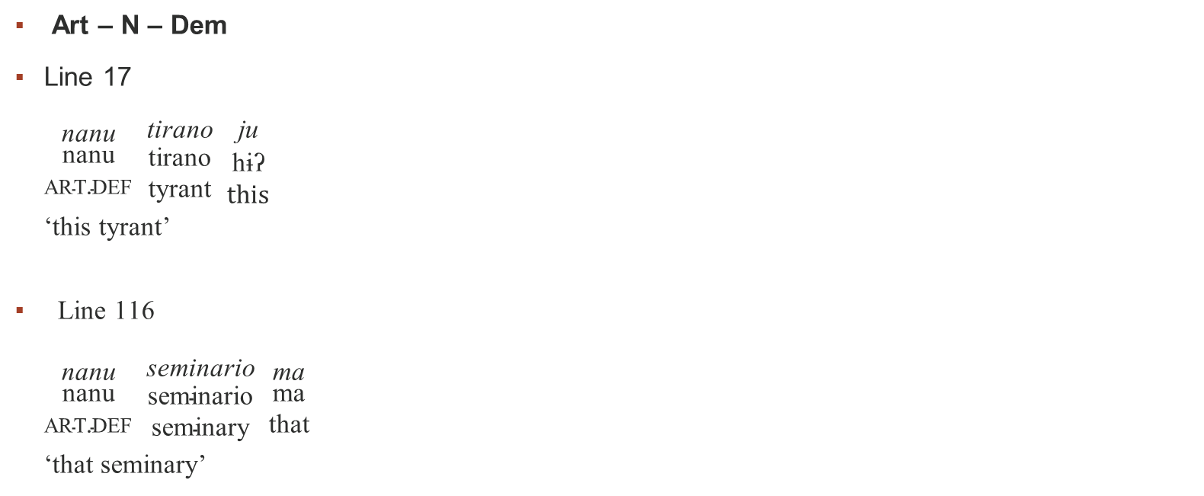
Morphosyntax: Xinkan-like demonstrative use
Art – N – Dem
Line 17
$\begin{matrix}\text{nanu} \\ \begin{matrix}\text{nanu} \\ \text{art}\text{.}\text{def} \end{matrix}\end{matrix}$ $\begin{matrix}\text{tirano} \\ \begin{matrix}\text{tirano} \\ \text{t}\text{yrant} \end{matrix}\end{matrix}$ $\begin{matrix}\text{ju} \\ \begin{matrix}\text{h}\text{ɨʔ} \\ \text{this} \end{matrix}\end{matrix}$
‘this tyrant’
Line 116
$\begin{matrix}\text{nanu} \\ \begin{matrix}\text{nanu} \\ \text{art}\text{.}\text{def} \end{matrix}\end{matrix}$ $\begin{matrix}\text{seminario} \\ \begin{matrix}\text{seminario} \\ \text{seminar}\text{y} \end{matrix}\end{matrix}$ $\begin{matrix}\text{ma} \\ \begin{matrix}\text{ma} \\ \text{t}\text{hat} \end{matrix}\end{matrix}$
‘that seminary’

Slide 16

Morphosyntax: word order changes
Line 257
$\begin{matrix}\text{muggobierno} \\ \begin{matrix}\text{m}\text{ɨ}\text{h}\text{− } & \text{Gobierno} \\ \text{3}\text{sg}\text{B}\text{/}\text{C} & \text{government} \end{matrix}\end{matrix}$ $\begin{matrix}\text{que} \\ \begin{matrix}\text{que} \\ \text{that} \end{matrix}\end{matrix}$ $\begin{matrix}\text{guiriqui} \\ \begin{matrix}\text{wirik}\text{′}\text{i} \\ \text{speak} \end{matrix}\end{matrix}$ $\begin{matrix}\text{naca} \\ \begin{matrix}\text{naka} \\ \text{you} \end{matrix}\end{matrix}$ $\begin{matrix}\text{kay} \\ \begin{matrix}\text{k}\text{′}\text{ay} \\ \text{over}\text{.}\text{there} \end{matrix}\end{matrix}$ $\begin{matrix}\text{hay} \\ \begin{matrix}\text{ay} \\ \text{pron}\text{.}\text{pl} \end{matrix}\end{matrix}$
‘it’s government that speaks to you (over there)’
‘Su gobierno os habla’
Lines 65-66
$\begin{matrix}\text{nanu} \\ \begin{matrix}\text{nanu} \\ \text{art}\text{.}\text{def} \end{matrix}\end{matrix}\begin{matrix}\text{Espa}\text{ñ}\text{a} \\ \begin{matrix}\text{Espa}\text{ñ}\text{a} \\ \text{Spa}\text{in} \end{matrix}\end{matrix}$ $\begin{matrix}\text{llugua} \\ \begin{matrix}\text{y}\text{ɨ}\text{w}\text{′}\text{a} \\ \text{los}\text{e} \end{matrix}\end{matrix}$ $\begin{matrix}\text{bal} \\ \begin{matrix}\text{pa}\text{ɬ} \\ \text{already} \end{matrix}\end{matrix}$
‘already Spain lost’
‘ya la España perdió’
Line 222
$\begin{matrix}\text{ena} \\ \begin{matrix}\text{wena} \\ \text{who} \end{matrix}\end{matrix}$ $\begin{matrix}\text{ti} \\ \begin{matrix}\text{ti}\text{ʔ} \\ \text{obj}\text{.}\text{ind} \end{matrix}\end{matrix}$ $\begin{matrix}\text{mughuca} \\ \begin{matrix}\text{m}\text{ɨ}\text{h}\text{− } & \text{uk}\text{′}\text{a} \\ \text{3}\text{sg}\text{B}\text{/}\text{C} & \text{estar} \end{matrix}\end{matrix}$ $\begin{matrix}\text{deber} \\ \begin{matrix}\text{deber} \\ \text{to}\text{.}\text{owe} \end{matrix}\end{matrix}$ $\begin{matrix}\text{tanto} \\ \begin{matrix}\text{tanto} \\ \text{so} \text{much} \end{matrix}\end{matrix}$ $\begin{matrix}\text{nanu} \\ \begin{matrix}\text{nanu} \\ \text{art}\text{.}\text{def} \end{matrix}\end{matrix}$ $\begin{matrix}\text{nacion} \\ \begin{matrix}\text{nacion} \\ \text{nation} \end{matrix}\end{matrix}$
‘to whom the nation owes so much’
‘a quien tanto debe la nación’

Slide 17
Morphosyntax: Verb conjugations
Verb forms: All Xinkan verbs have two forms
  Transitive
    Perfective: CVC(’)V-
    Imperfective: -CVC’V
  Agentive intransitive
    Perfective: -CVC(’)Vɬaʔ
    Imperfective -CVC’V
  Affective intransitive
    Perfective: -CVVCVʔ
    Imperfective: -CVCVʔ
Zeeje manuscript
  lacama = ɬakam’a ‘tell’
  lugnu/lucumu = ɬɨhnɨ/ɬikɨn’ɨ ‘believe’
  tagna/tagana = tahna/tahan’a ‘grow’
  cula/cu = kuɬaʔ/ku ‘go’
  cutú = k’ɨɨtɨʔ ‘measure’

Slide 18

Numbers
  MA-style numbering
  Line 235
  $\begin{matrix}\text{nanu} \\ \begin{matrix}\text{nanu} \\ \text{art}\text{.}\text{def} \end{matrix}\end{matrix}$ $\begin{matrix}\text{cal} \\ \begin{matrix}\text{ik}\text{′}\text{a}\text{ɬ} \\ \text{one} \end{matrix}\end{matrix}$ $\begin{matrix}\text{frag} \\ \begin{matrix}\text{frak} \\ \text{man} \end{matrix}\end{matrix}$ $\begin{matrix}\text{pi} \\ \begin{matrix}\text{pi} \\ \text{two} \end{matrix}\end{matrix}$ $\begin{matrix}\text{ti} \\ \begin{matrix}\text{ti}\text{ʔ} \\ \text{of}\end{matrix}\end{matrix}$ $\begin{matrix}\text{Julio} \\ \begin{matrix}\text{Julio} \\ \text{Ju}\text{ly} \end{matrix}\end{matrix}$
‘el 22 de julio’
Line 242
  $\begin{matrix}\text{pi} \\ \begin{matrix}\text{pi} \\ \text{two} \end{matrix}\end{matrix}$ $\begin{matrix}\text{frag} \\ \begin{matrix}\text{frak} \\ \text{man} \end{matrix}\end{matrix}$ $\begin{matrix}\text{mola} \\ \begin{matrix}\text{mool}\text{′}\text{a} \\ \text{month} \end{matrix}\end{matrix}$
‘thirty months’ (lit. ‘forty months’)

Slide 19
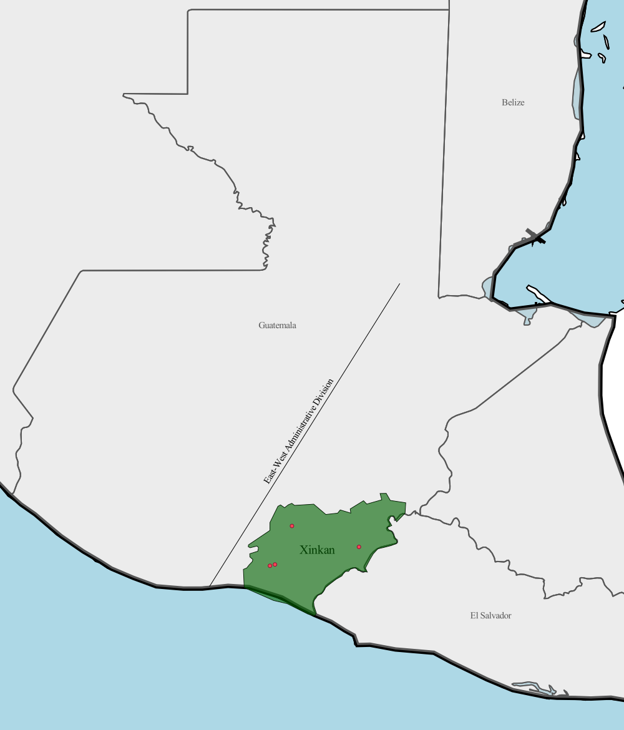
What other sociolinguistic information adds to the context of this translation?
  Eastern-Western division
    History of the conquest
      East = commerce, trade
      West = agriculture
    Secular-Regular orders administration
      East = secular Orders
      West = regular Orders
    Acculturation
      East = hispanization
      West = indigenization

Slide 20
The Zeeje Manuscript
The Zeeje manuscript is a linguistic representation of the complex geographic and social landscape of the Xinkan region
Not a poor translation, but accurate representation of the place of Xinkan in Eastern Guatemala.
  There were native speakers, but it is likely that they would have adopted the high levels of mixing that is present in the manuscript.
The Zeeje manuscript using a mix of languages Spanish and the four Xinkan languages, reflecting the assimilation and linguistic leveling valued in the eastern part of colonial Guatemala.

Slide 21
What does this mean for language description and revitalization?
The Xinkan languages are a construct which reflect a long and complex social history
Descriptions should be valid but one source of data does not represent this construct better than another – it simply different.
  The Zeeje manuscript actually reveals aspects of colonial society and grammar that may not be known otherwise.
Revitalization should focus on the value of a language not necessarily the standardization of a language.
  The outcome of revitalization should be flexible to allow for different forms and a lot of borrowing
  No comparative judgment

